Slide 1
19 April 2025 Mason-Dixon Line Severe MCS and Downburst Outbreak

Slide 2
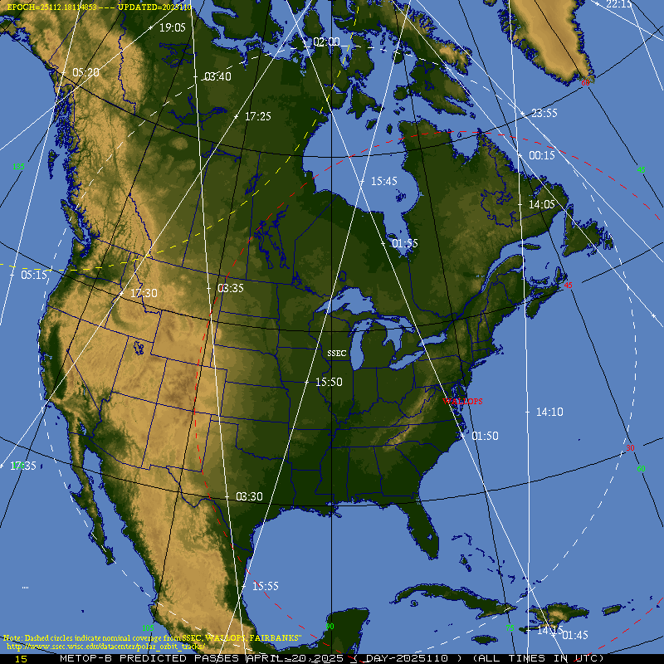
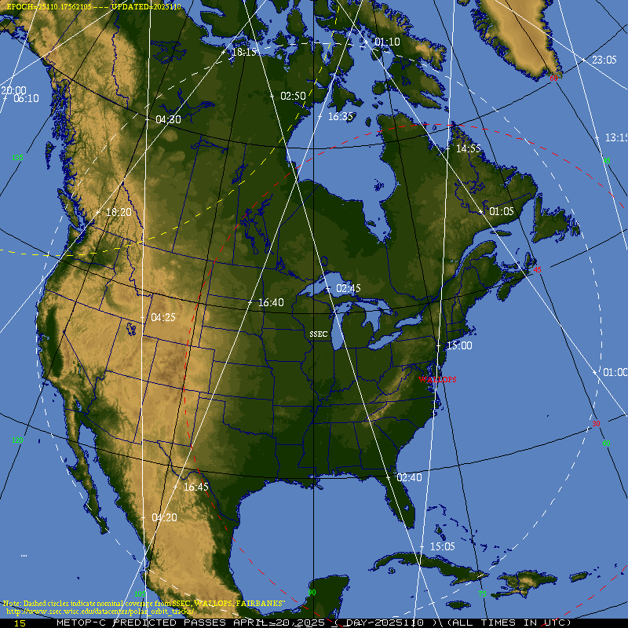
METOP-B/METOP-C Overpasses 20 April 2025
https://www.ssec.wisc.edu/datacenter/polar_orbit_tracks/

Slide 3
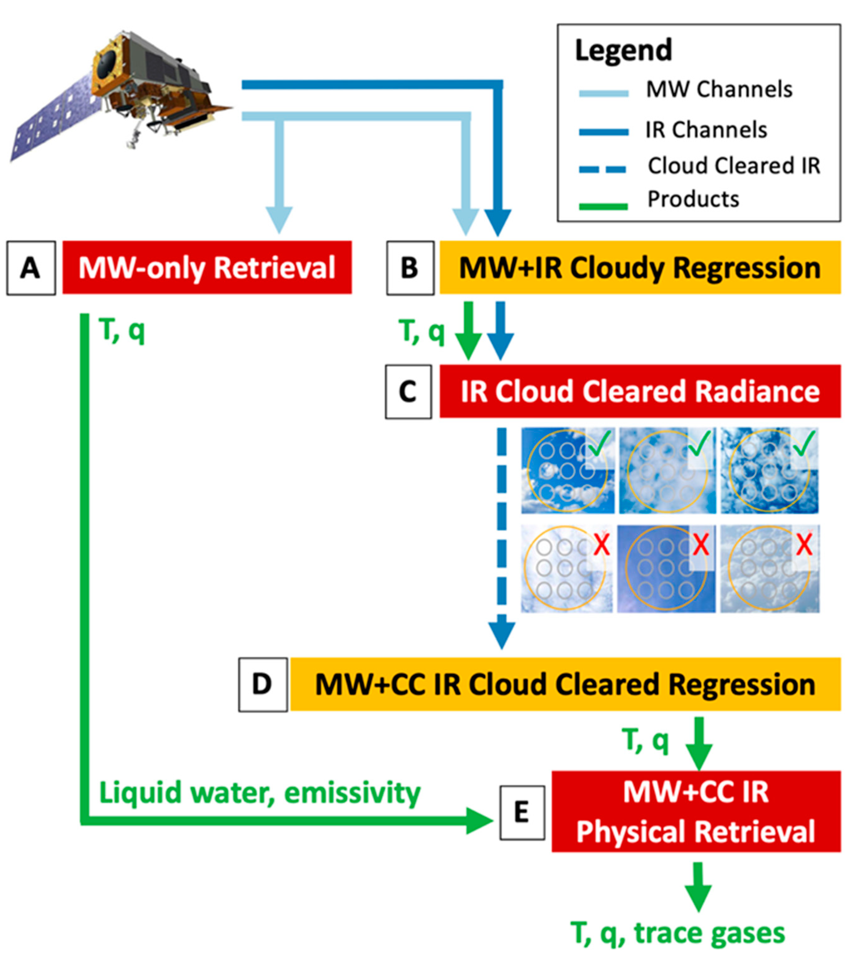
NOAA Unique Combined Atmospheric Processing System (NUCAPS)
High-level flow chart of the step-wise NOAA-Unique Combined Atmospheric Processing System (NUCAPS) retrieval algorithm that outputs temperature (T), moisture (q) and trace gases.
NUCAPS retrievals of T, q and ozone (O3) are color-coded as red, yellow and green to indicate if and when they failed quality control checks.
Steps B and D, which are yellow black text, are regression steps, and if they fail they will be flagged as yellow in AWIPS; these retrievals should be used with caution.
Steps A, C, and E, which are red with white text, are cloud clearing or retrieval stages of the algorithm. If any of these fails, the retrieval is unlikely to yield meaningful results, and they will be flagged red in AWIPS.
The entire algorithm runs regardless if any one step passes or fails.
Courtesy Esmaili et al. (2020): https://doi.org/10.3390/rs12050886
Rosenkranz (2001)
Notes:
The NUCAPS algorithm consists of the following six modules as summarized below.
1. Preliminary input quality control, look-up tables (LUT), and ancillary product acquisition.
2. The microwave-only (MW-only) retrieval module which derives cloud liquid
water flags and microwave (MW) surface emissivity uncertainty (Rosenkranz,
2001).
3. An all-sky fast eigenvector regression retrieval for temperature and moisture
that is trained against ECMWF analysis and CrIS all-sky radiances (Goldberg
et al., 2003).
4. A cloud-clearing module that combines a set of MWand thermal infrared (TIR)
channels (along with, in the future, visible observations provided by the onboard
VIIRS instrument) to produce cloud-cleared TIR radiances (Chahine, 1974).
5. A cloud-cleared fast eigenvector regression retrieval for temperature and
moisture that is trained against ECMWF analysis and CrIS cloud-cleared radiances
(Goldberg et al., 2003).
6. The final IR physical retrieval, which employs the previous regression retrieval
as the first-guess for temperature and water vapor (Susskind et al., 2003).

Slide 4
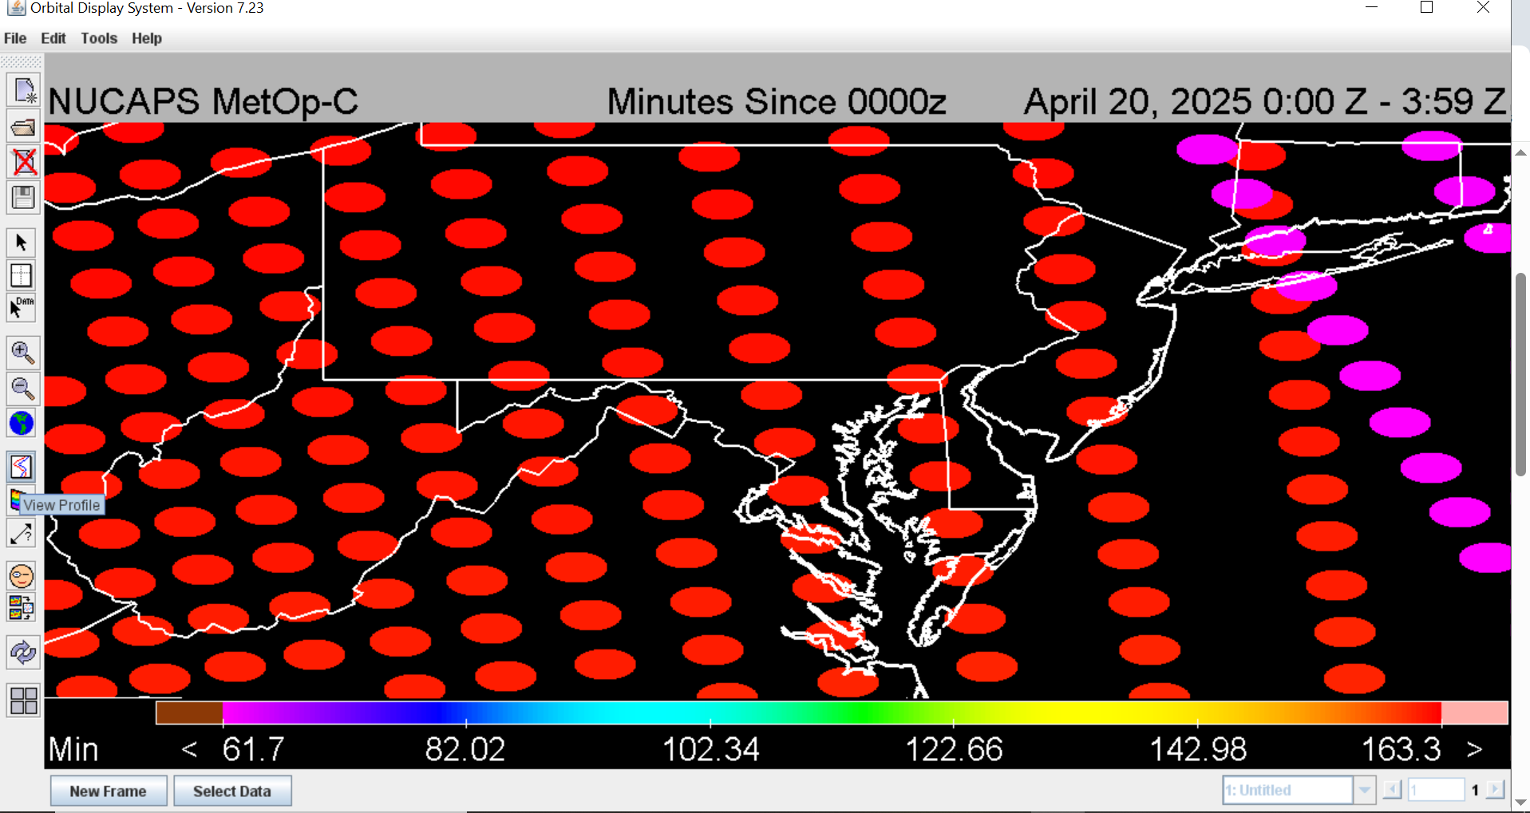
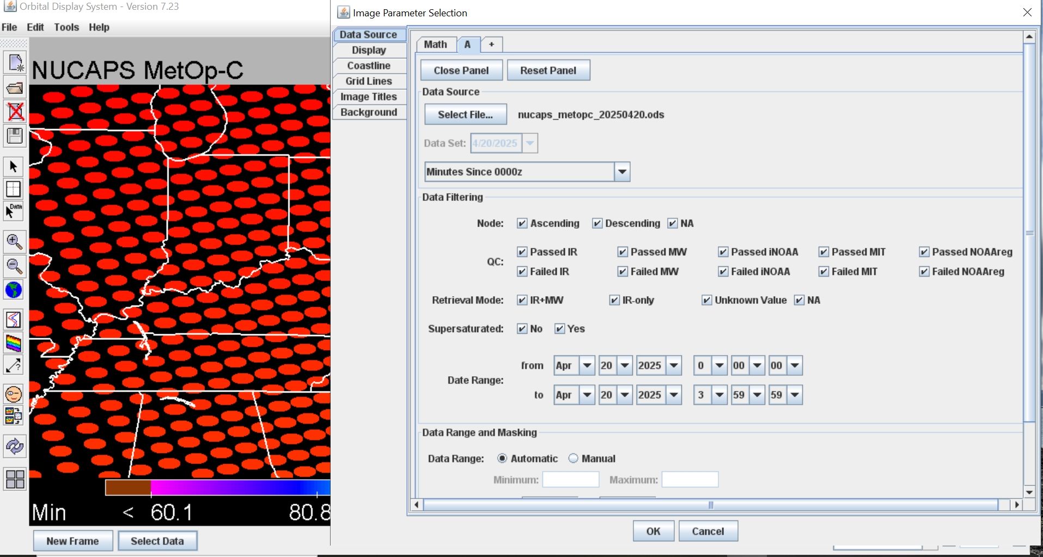
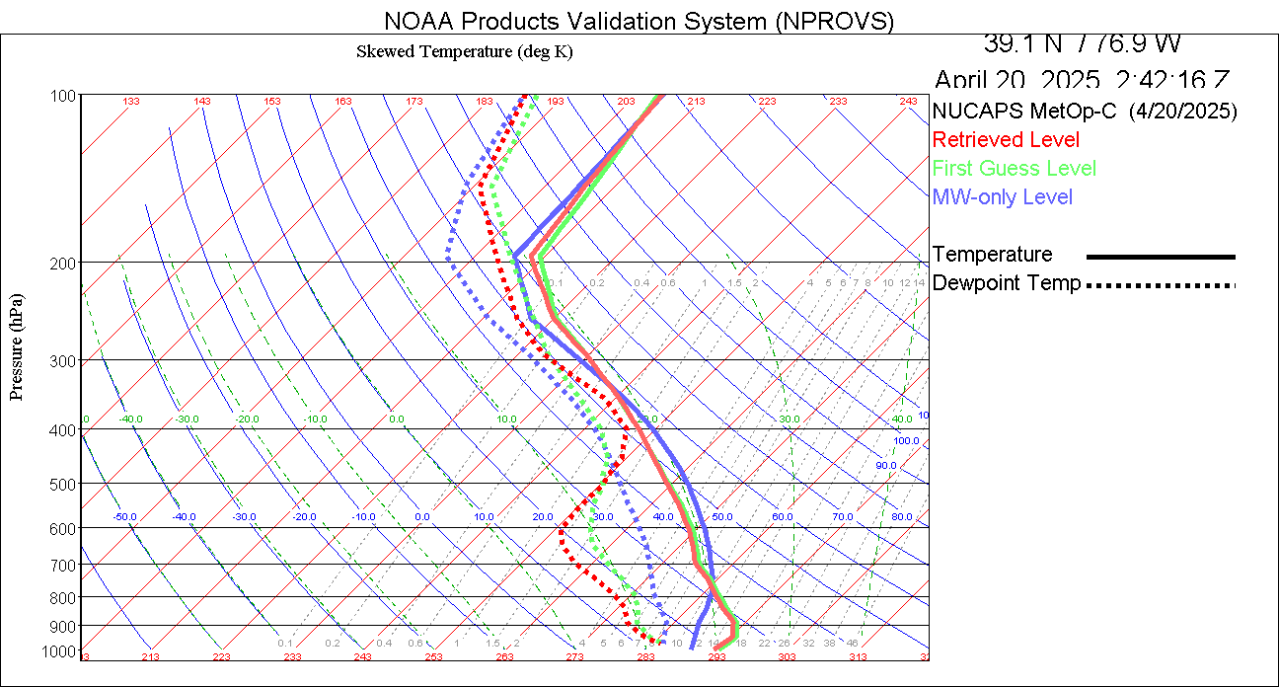
Operational NPROVS Demonstration

Slide 5
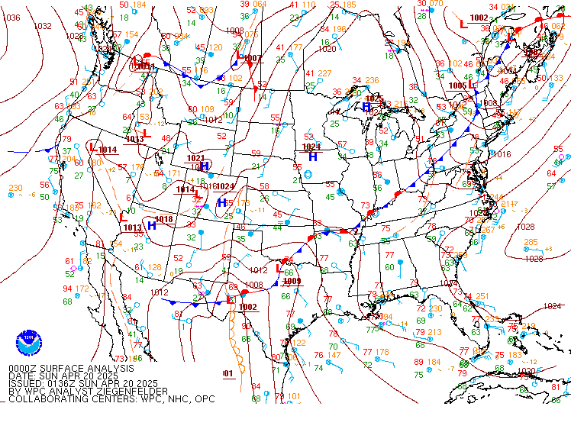
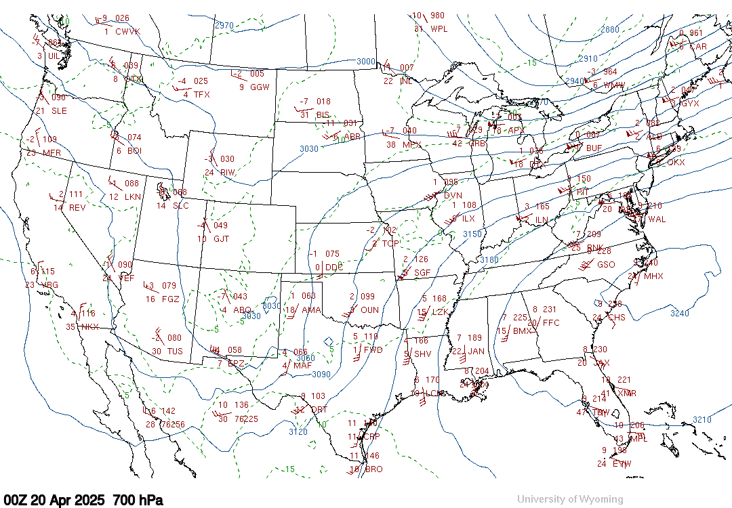
Synoptic Analysis of the Storm Environment

Slide 6
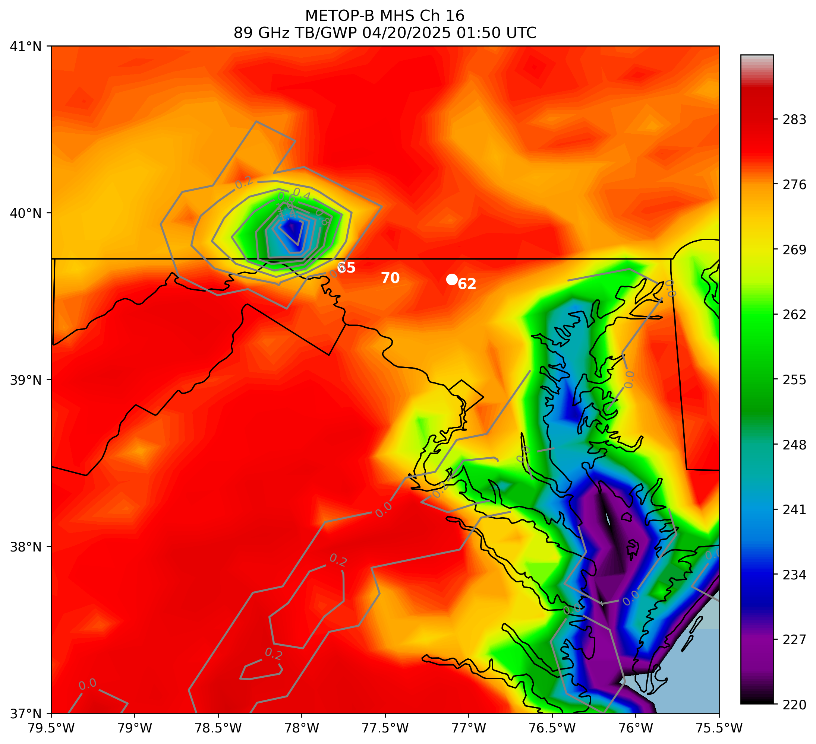
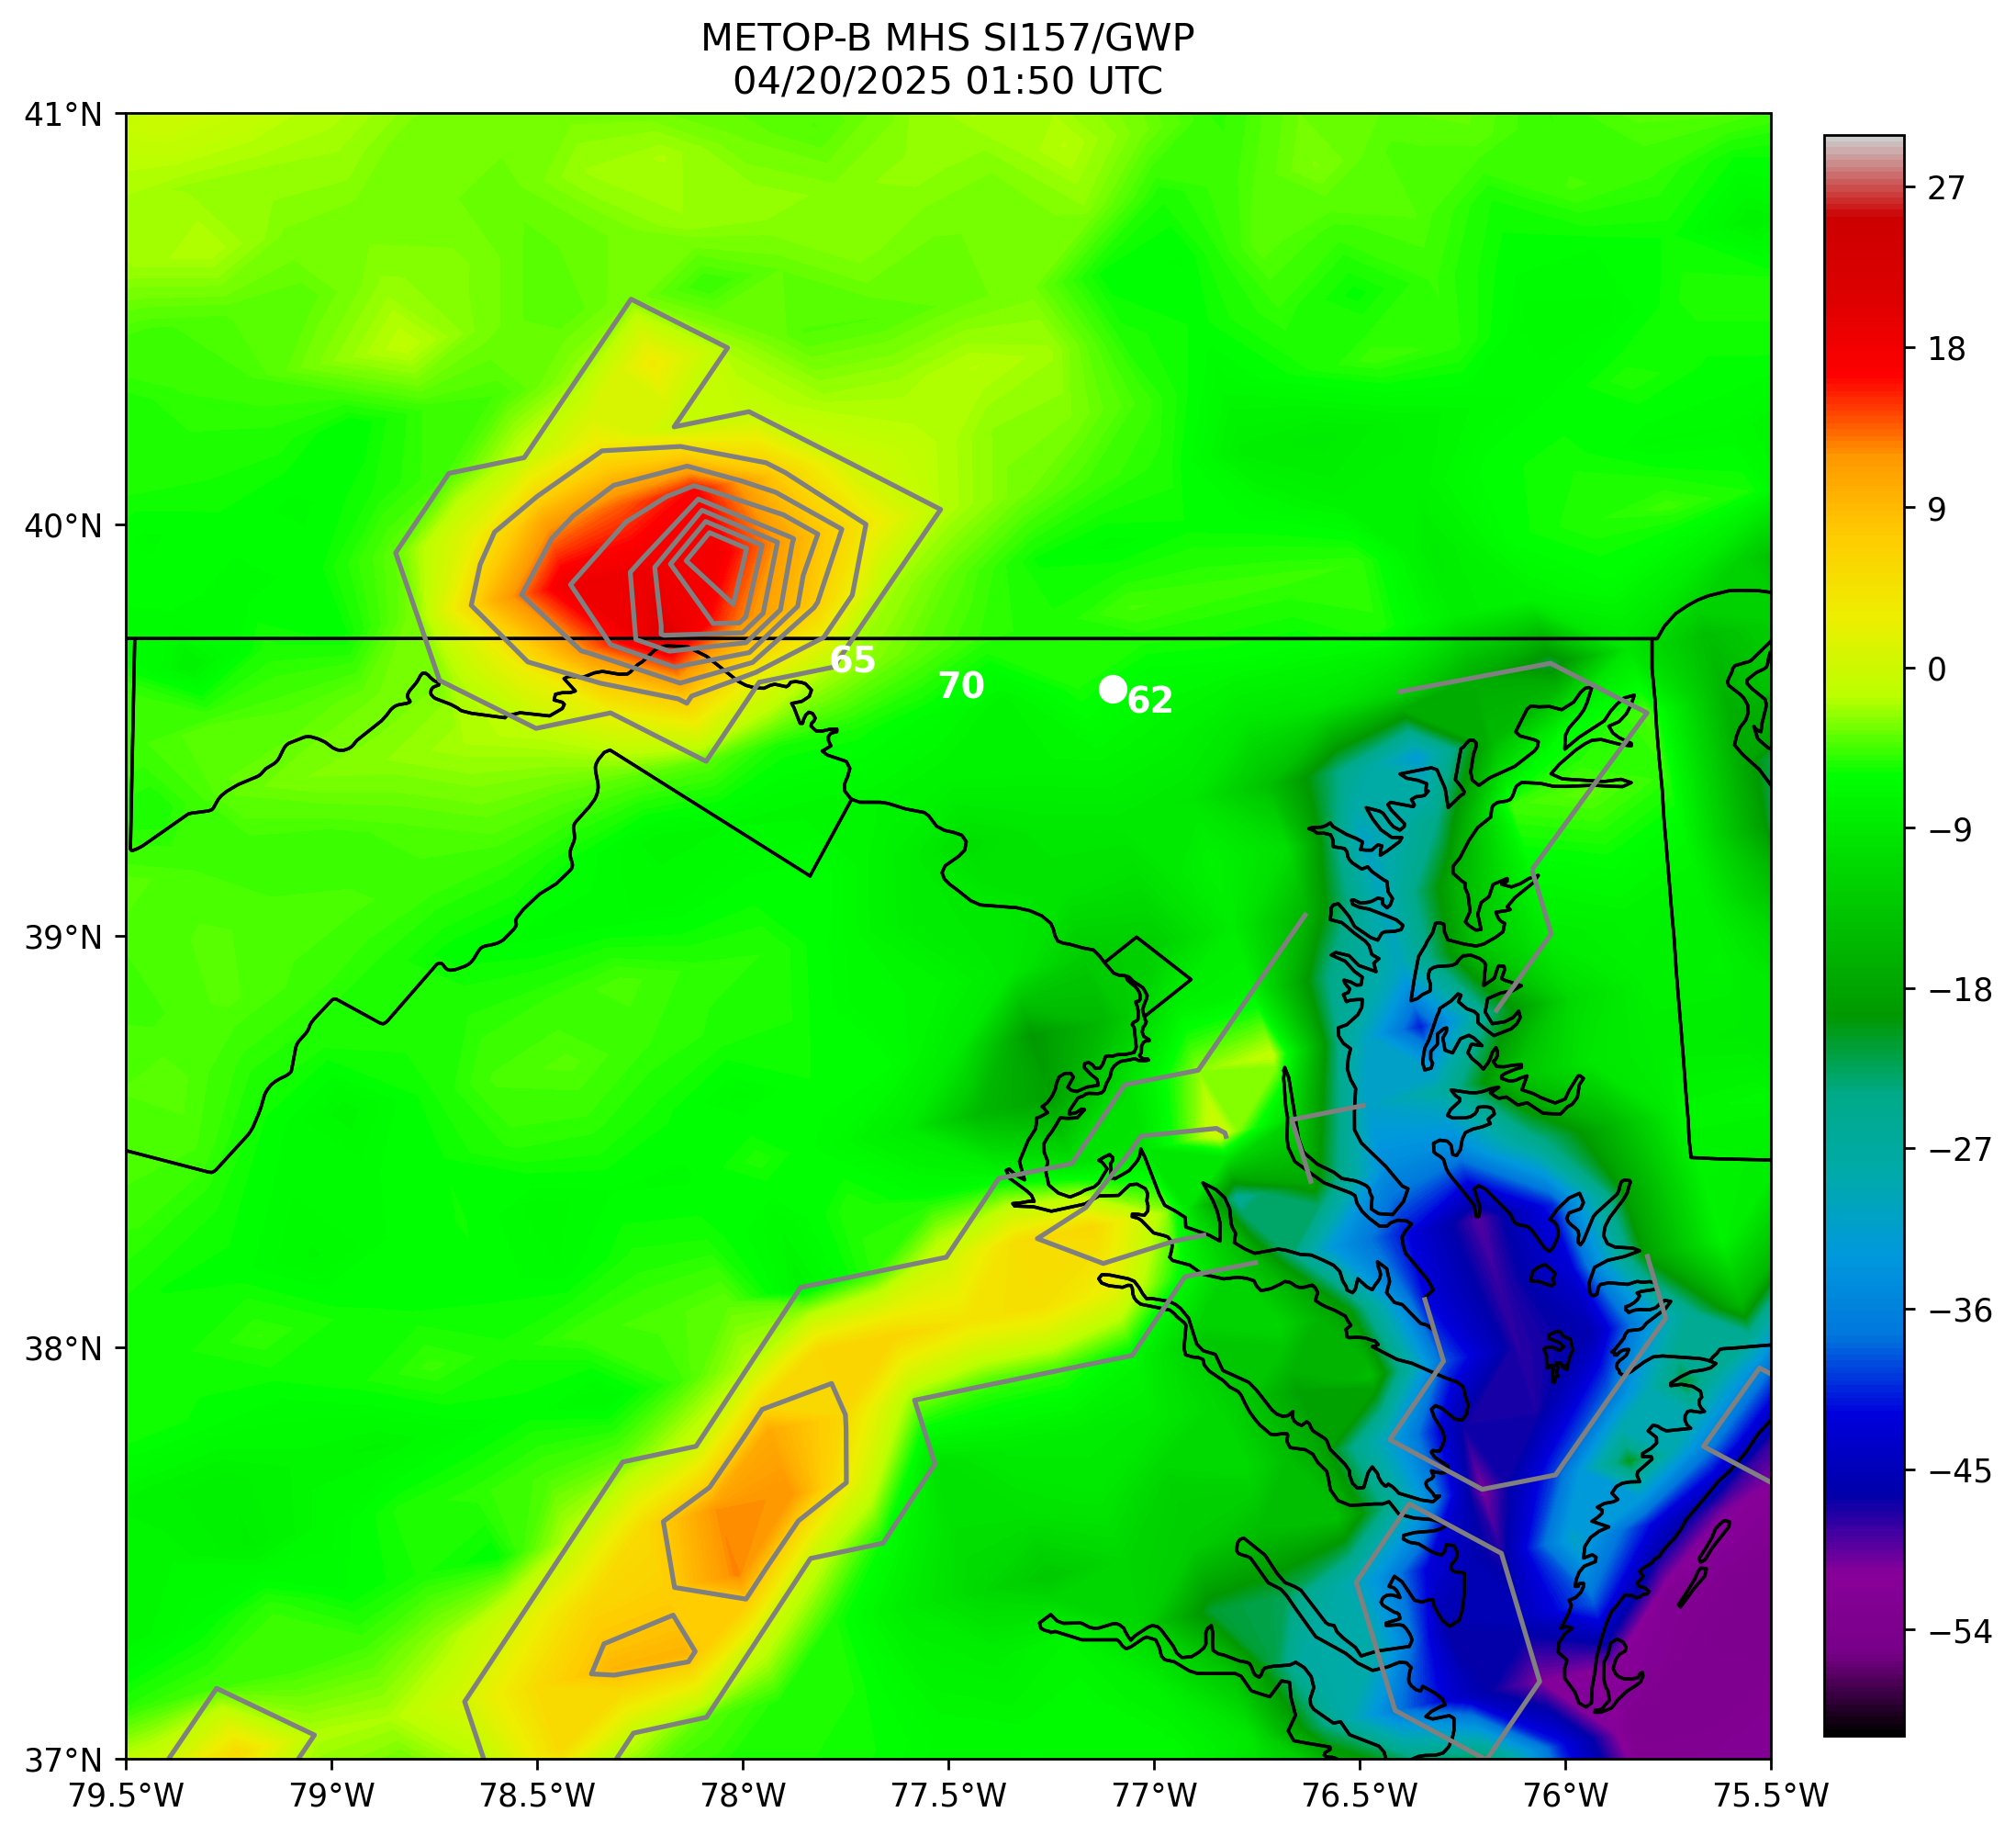
“65”, “70”, and “62” represent measured downburst wind gusts in knots.
White circle represents the 0242 UTC METOP-C NUCAPS sounding retrieval location near Westminster, MD.
Notes:
Pass- 0: Accepted

Slide 7
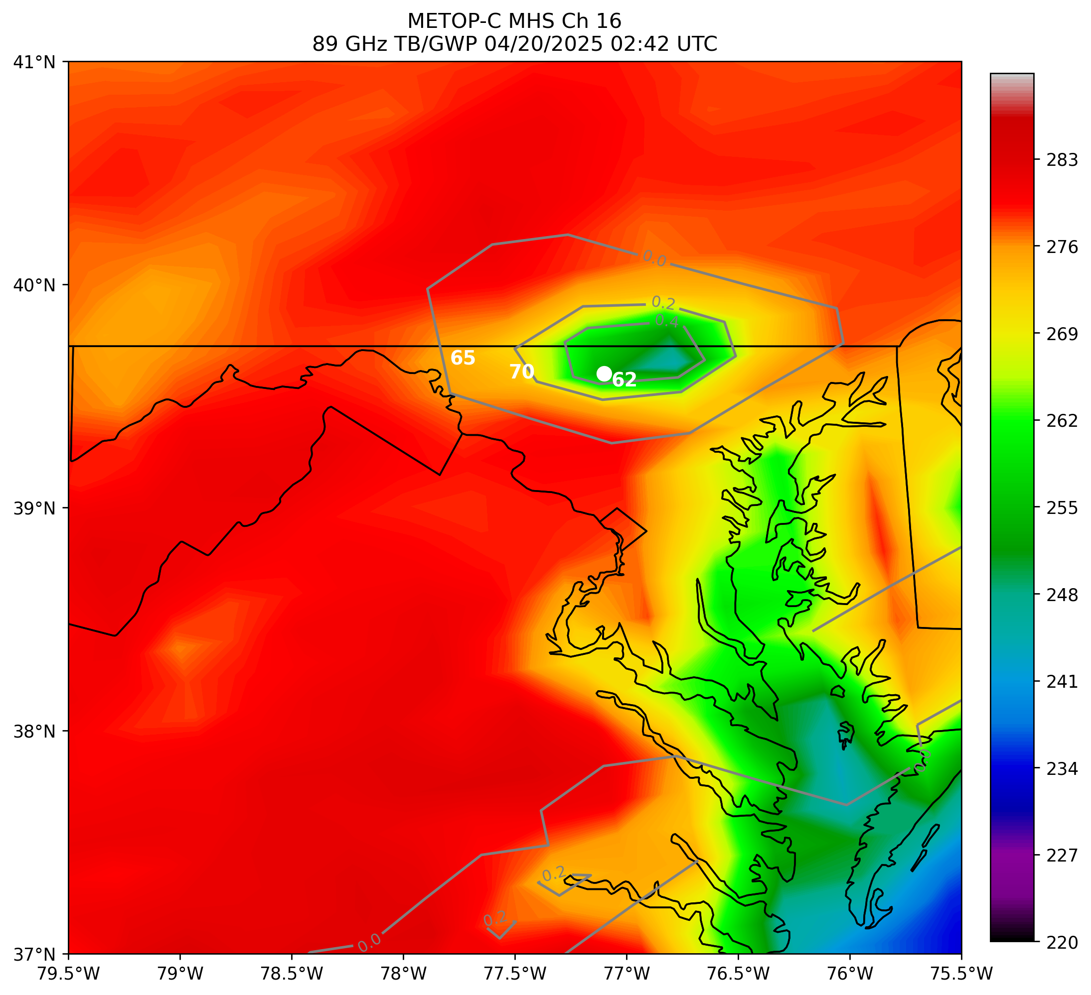
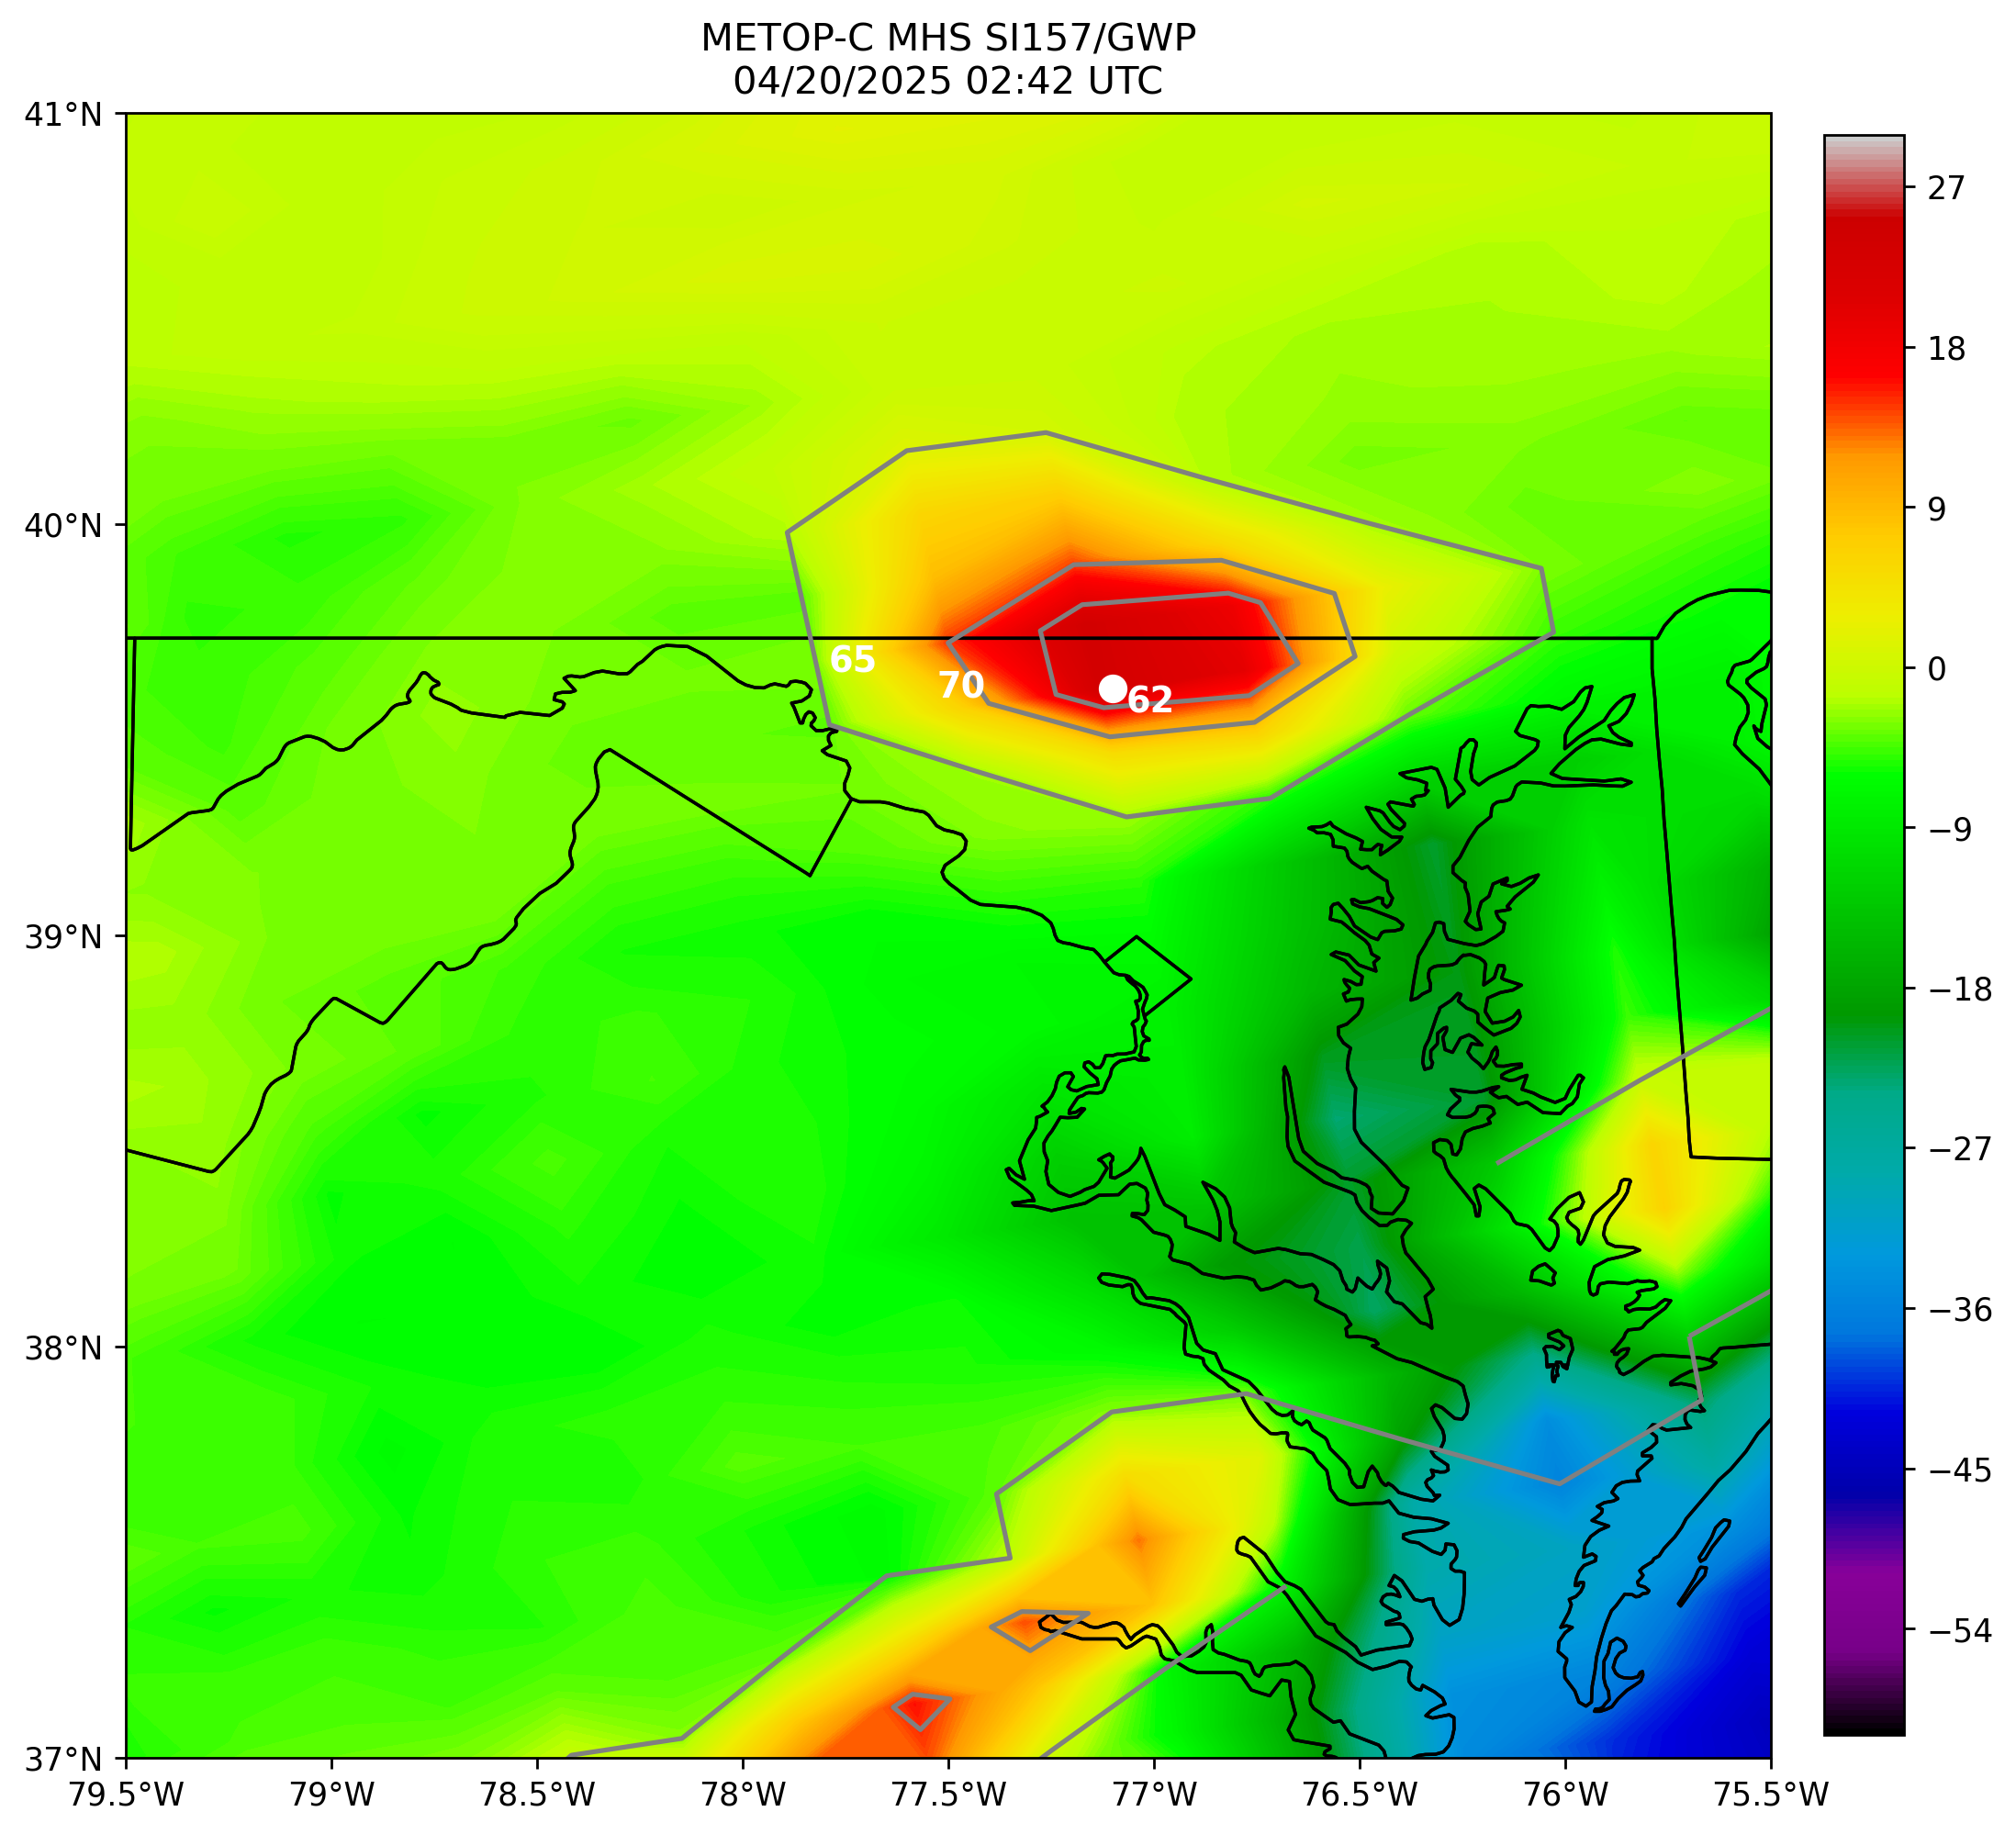
“65”, “70”, and “62” represent measured downburst wind gusts in knots.
White circle represents the 0242 UTC METOP-C NUCAPS sounding retrieval location near Westminster, MD.
Notes:
Pass- 0: Accepted

Slide 8
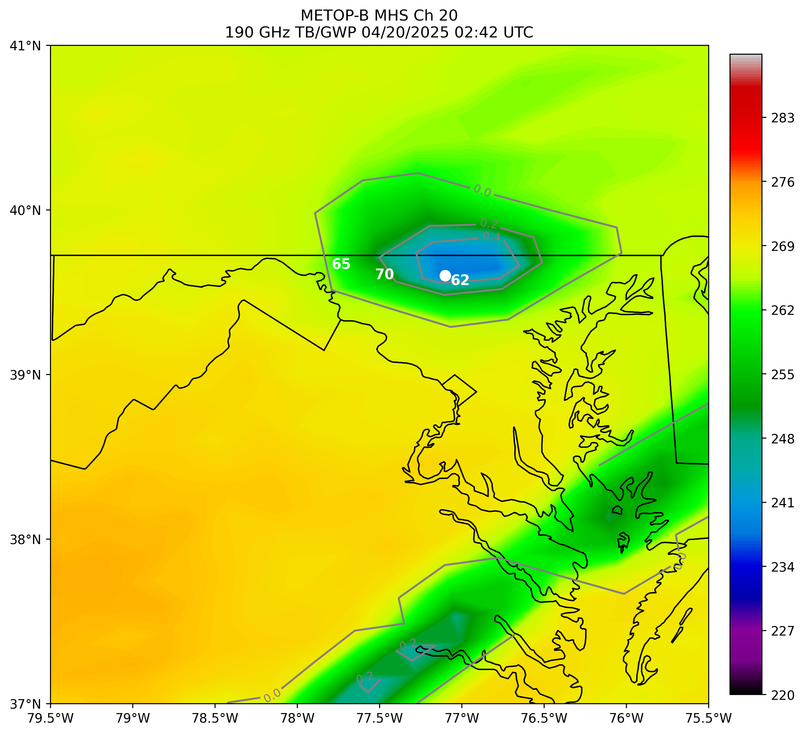
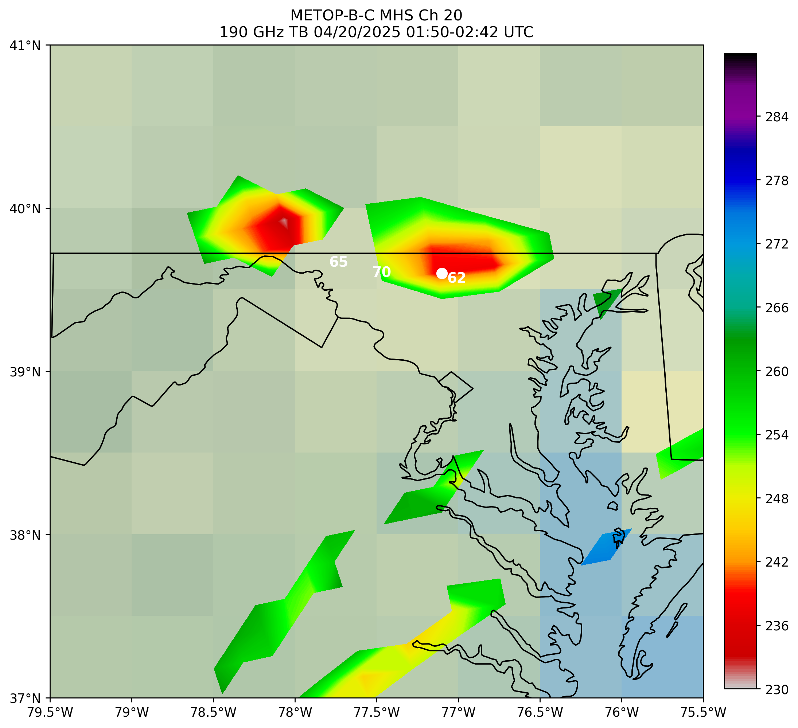
METOP-B
METOP-C
Storm motion: 65 knots
“65”, “70”, and “62” represent measured downburst wind gusts in knots.
White circle represents the 0242 UTC METOP-C NUCAPS sounding retrieval location near Westminster, MD.
Notes:
Pass- 0: Accepted

Slide 9


METOP-B
METOP-B
METOP-C
METOP-C
Storm motion: 65 knots
“65”, “70”, and “62” represent measured downburst wind gusts in knots.
White circle represents the 0242 UTC METOP-C NUCAPS sounding retrieval location near Westminster, MD.

Slide 10
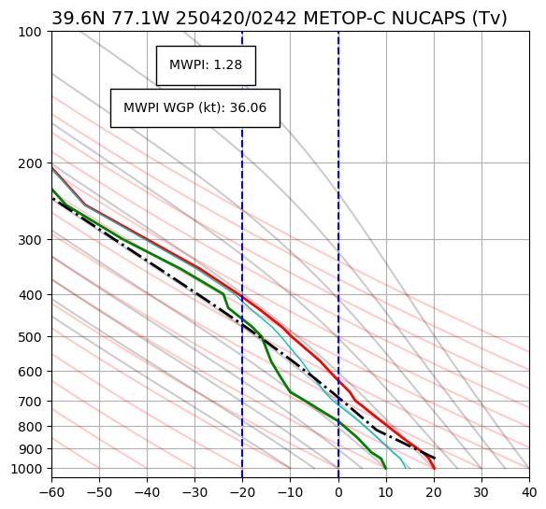
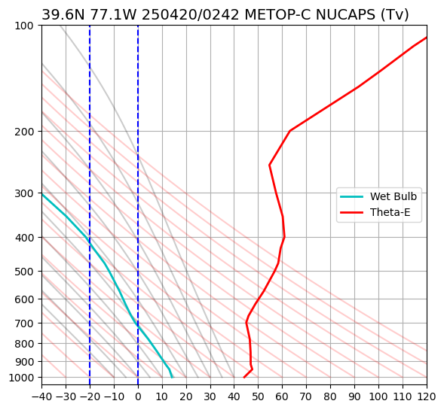
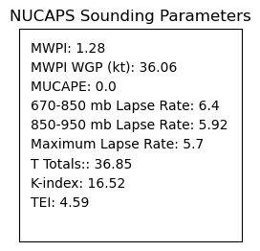
Near Westminster, MD
Accepted Retrieval
Miller (1972) Type 1 profile
WGP + 22 = 58 kt
Convective/potential instability
WBZ
Notes:
Pass- 0: Accepted

Slide 11
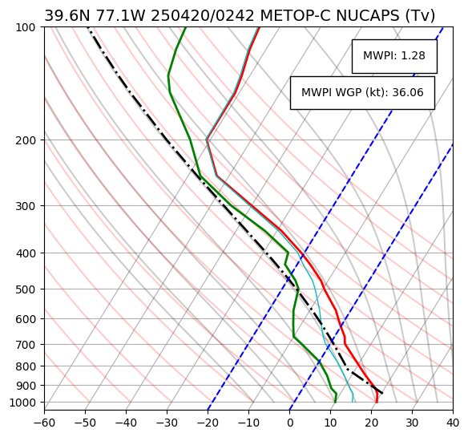
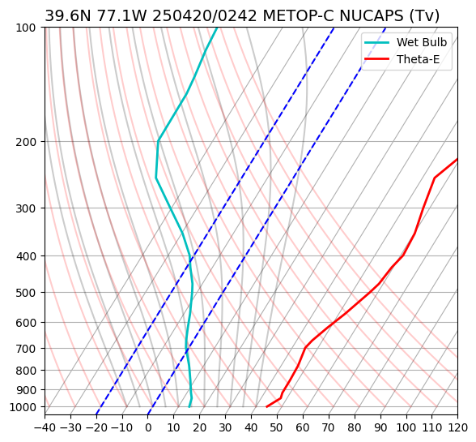
Near Westminster, MD
Accepted Retrieval
Miller (1972) Type 1 profile
WGP + 22 = 58 kt
Mid-tropospheric unsaturated layer
Convective/
potential instability
WBZ

Slide 12
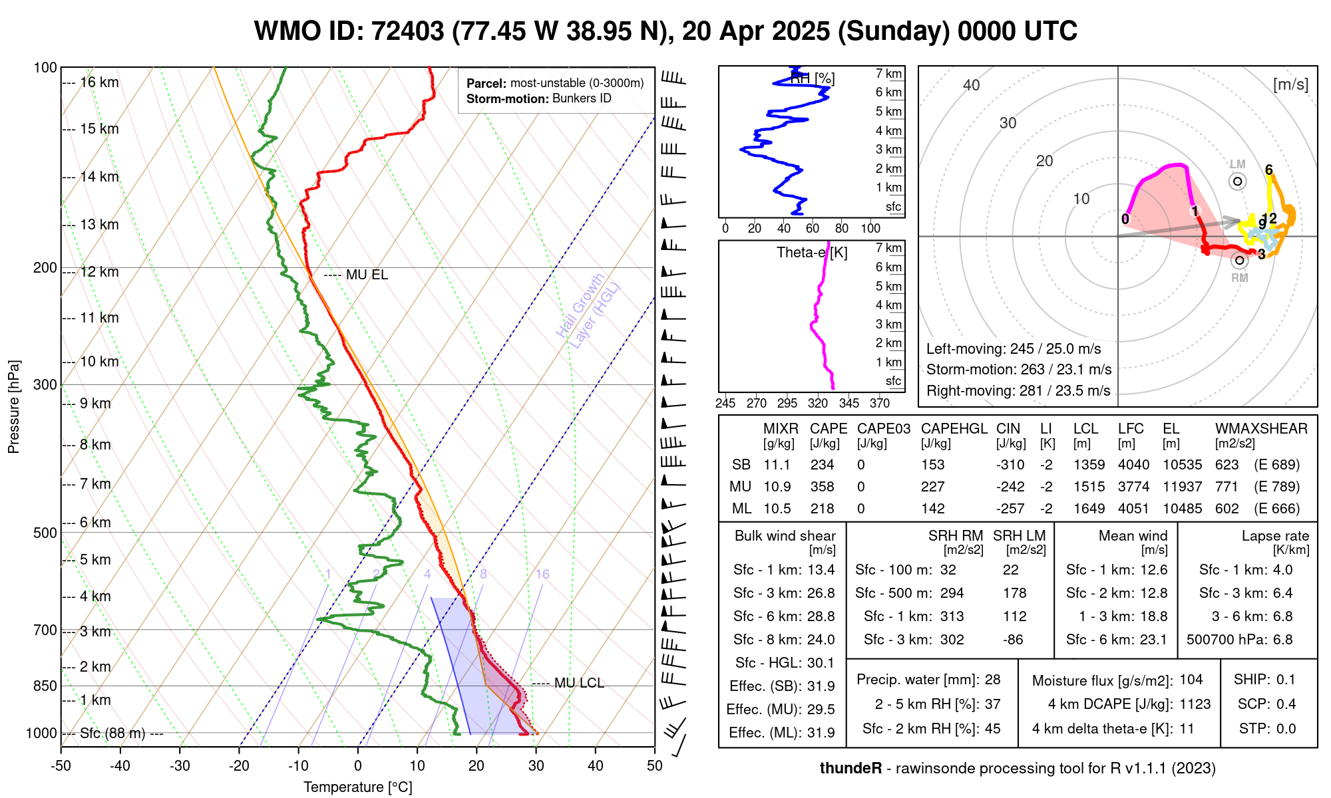
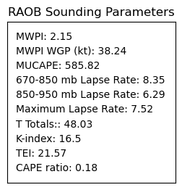
WGP + 22 = 60 kt
WBZ
Downdraft energy

Slide 13
